Slide 1

(C) Basic Business Statistics with R

Slide 2
In this session…
I would like to review useful concepts in statistics (with R) before starting marketing analytics using R.

Slide 3
Topics
Probability and distribution
Sampling distribution and Central Limit Theorem (CLT)
Descriptive summary for data
Data visualization
Frequency analysis

Slide 4
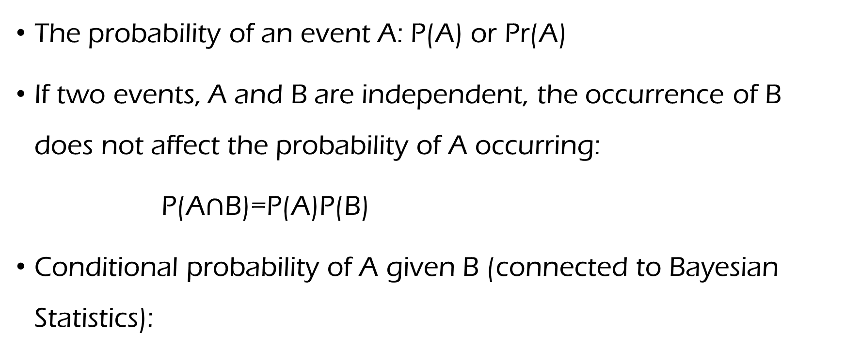
Brief review of probability
The probability of an event A: P(A) or Pr(A)
If two events, A and B are independent, the occurrence of B does not affect the probability of A occurring:
P(A$∩$B)=P(A)P(B)
Conditional probability of A given B (connected to Bayesian Statistics):

Slide 5
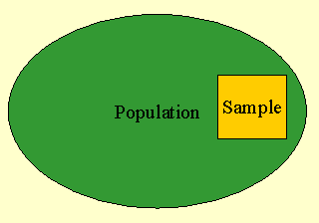
Population: -- Total of all elements (people) that share some common characteristic(s) -- Goal of Statistics: learn about it (‘Truth’)
The two ‘key’ concepts in Statistics
Sample: -- A subset of a population -- Goal of Sample Analytics: use sample to learn about population

Slide 6
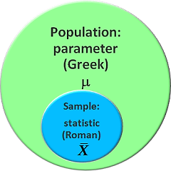
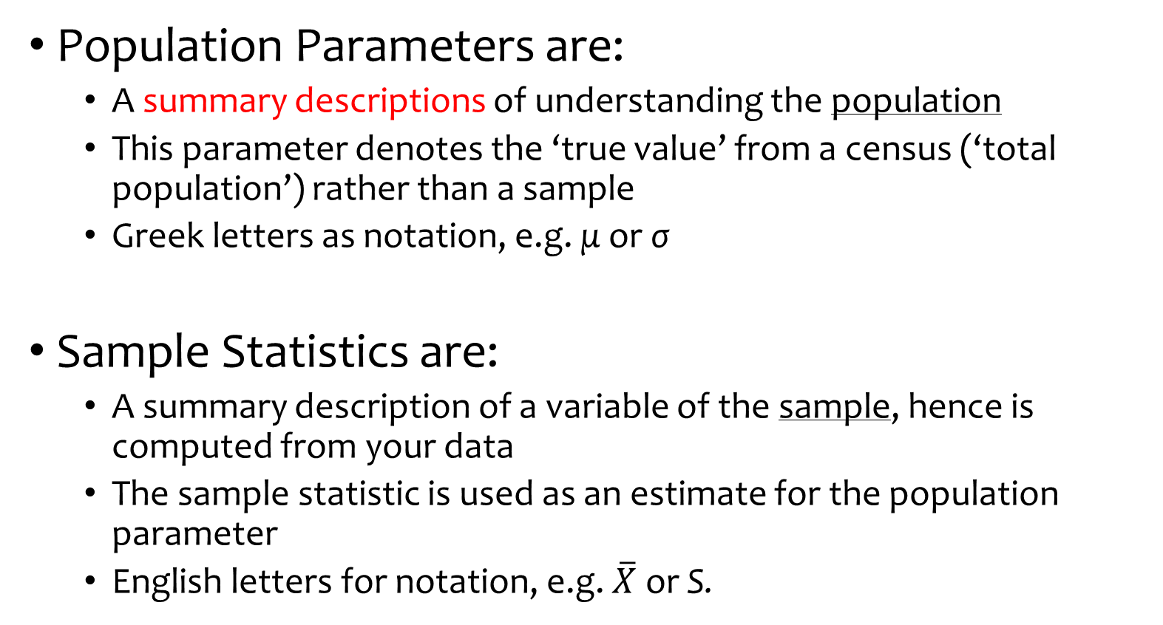
The two ‘key’ concepts in Statistics
Population Parameters are:
A summary descriptions of understanding the population
This parameter denotes the ‘true value’ from a census (‘total population’) rather than a sample
Greek letters as notation, e.g. μ or σ
Sample Statistics are:
A summary description of a variable of the sample, hence is computed from your data
The sample statistic is used as an estimate for the population parameter
English letters for notation, e.g. $\overline{X}$ or S.
Thus, we want to infer the true (population) parameters! E.g., it is our best guess!!!

Slide 7
Topic 1 in Workshop (C): Probability
Probability by generating random number with R
Using R, with 100 coin tosses, what is probability for having ‘head’?\
How about 1000 coin tosses? How about 100,000?

Slide 8
Practice: Topic 1 in Workshop (C):
Using R, do a simulation study. With 1000 times toss of a fair dice, what is probability for having ‘1’? Before running R, what probability can you expect? Can you observe what you expect?
Increase the number of times to 1000,000. What proportion can you observe?

Slide 9
Descriptive statistics: Let’s first see how data looks like…
Descriptive statistics: Summarize the data with a few revealing numbers (e.g., parameters): How data looks like? (Intuitively and visually…)
Numerical summaries
Central tendency: E.g., Mean, Proportion and Median.
Measures of dispersion: E.g., Standard Deviation, Variance, Range.
Those are also kinds of parameters.
Graphical summaries
e.g. Histogram, Varous Plots
We would like to think about concepts but I don’t think we have to discuss how to compute those… Nobody doesn’t know mean and variance… ☺
We will see how to do this with R soon!

Slide 10
Topic 2 in Workshop (C): Basic descriptive summary with R
Let’s use Professor Salary Data…
Basic descriptive statistics with R
Mean
Median
Range
Variance
Standard deviation
Quantiles (25%, 75%)
You don’t have to memorize the R commands… You can easily search these online.

Slide 11


Example Data: Average Usage Time (minutes) per Day for Instagram
A Question of Marketing Manager of Instagram
“Are the teen-age girls in US spending more time per day in Instagram than the teen-age girls in Europe?”
Let’s do descriptive summaries first.

Slide 12
Practice: Topic 2 in Workshop (C):
Do descriptive summary with the Instagram data…
What is mean value, 40%, 60% quantiles of using Instagram by US teen girls?
What is min/max, 90% quantile value of using Instagram by US teen girls?

Slide 13
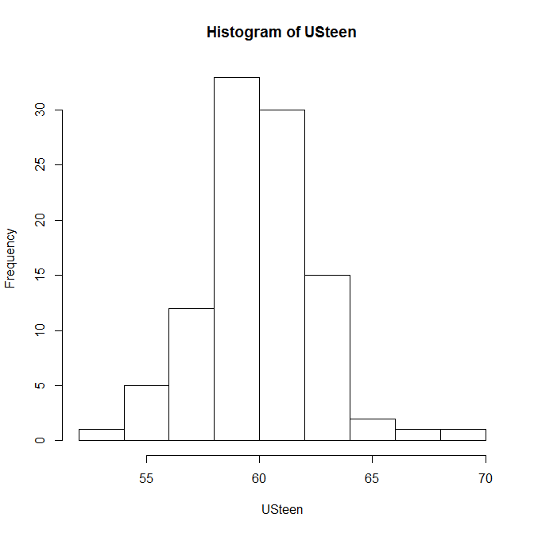
Let’s review the concept of distributions: Histogram by small sample (n=100)

Slide 14
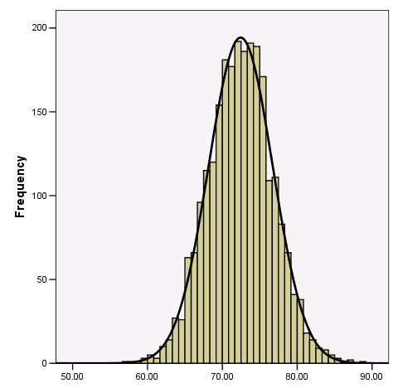
Histogram with population… (smooth line)
Let’s assume we can increase sample to almost whole population!
We want to learn about these ‘smooth lines’.
Because managerial decisions should be made for a population (Not for samples).

Slide 15
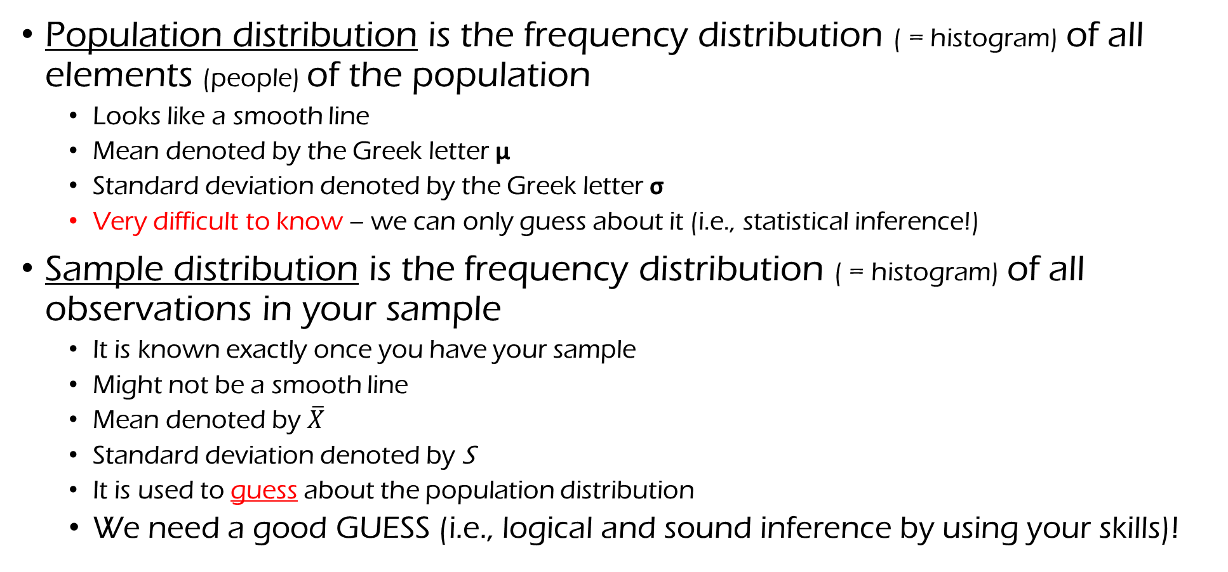
Statistical definitions: Summary
Population distribution is the frequency distribution ( = histogram) of all elements (people) of the population
Looks like a smooth line
Mean denoted by the Greek letter μ
Standard deviation denoted by the Greek letter σ
Very difficult to know – we can only guess about it (i.e., statistical inference!)
Sample distribution is the frequency distribution ( = histogram) of all observations in your sample
It is known exactly once you have your sample
Might not be a smooth line
Mean denoted by $\overline{X}$
Standard deviation denoted by S
It is used to guess about the population distribution
We need a good GUESS (i.e., logical and sound inference by using your skills)!

Slide 16
Random Variable
Its value is subject to variations due to chance (i.e. randomness, in a mathematical sense). A random variable conceptually does not have a single, fixed value (even if unknown); rather, it can take on a set of possible different values, each with an associated probability.
Discrete RV : E.g., Number of new subscribers to a magazine.
Continuous RV: E.g., Time (a day) of Instagram by teen-girls
Usually, we can assume a probability distribution for this random variable. -- Parametric approach (why?)

Slide 17
(Special) Probability Distributions
A probability distribution assigns a probability to each of the possible outcomes (events).
E.g., Uniform distributions, Normal Distribution, Bernoulli Distribution, etc.
In most cases, if we know its parameter(s), we can know how the distributions look like.

Slide 18
Special Distributions – Examples
Discrete
binomial
Poisson
Geometric, etc…
Continuous
Normal
gamma
exponential
Student’s t
chi-square
Uniform, etc…
Note: Choice of distribution to use depends upon the characterization of the random variable as well as the particular properties of the distribution.

Slide 19
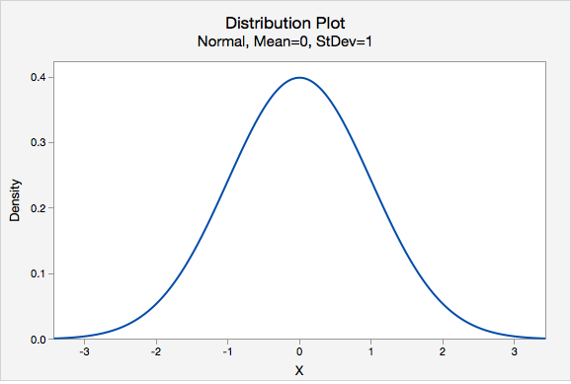
Normal distribution
The most useful and popular distribution: Used for confidence Interval or Hypothesis Testing → Inferential statistics.
An important characteristic (population):
Fully described by its mean μ and standard deviation σ: you only need to know these two parameters to draw the smooth line.
With μ and σ, we can compute probability values: computing Area.
Normal distribution example in Real Life:
Amount of time watching television, Height, or I.Q. (but not income).

Slide 20
Topic 3 in Workshop (C): Normal Distribution
Let’s use Normal Distribution in R
Probability (‘pnorm’ in R).
Quantile (‘qnorm’ in R).
Random number generation from Normal Distribution (‘rnorm’ in R): in modern analytics, simulation technique is important!

Slide 21
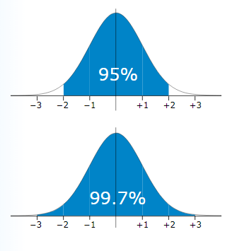
Probability (area) (pnorm in R)
1.96
Quantiles values (qnorm in R)

Slide 22
Practice: Normal Distribution
Using R, what is quantile values for 95% and 99.5% probability in standard normal distribution?
Probability using normal distribution:
What is probability with quantile value of 0 in normal distribution with mean 1 and sd 1?
What is probability with quantile value of 0 in normal distribution with mean 1 and sd 2?

Slide 23
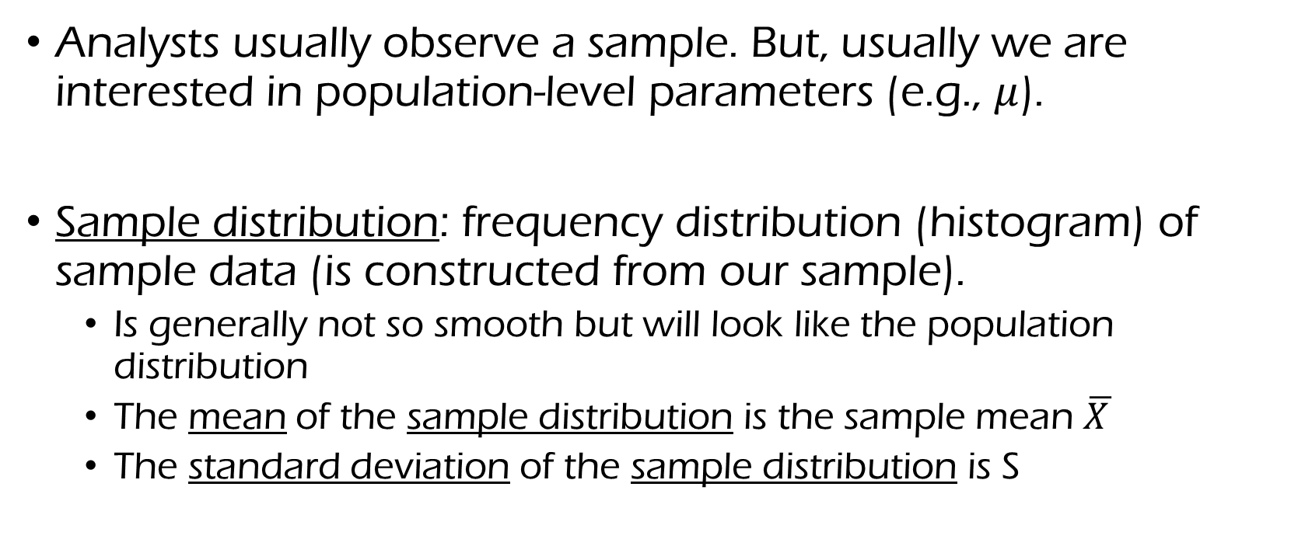
Objective of statistical inference
Analysts usually observe a sample. But, usually we are interested in population-level parameters (e.g., $μ$).
Sample distribution: frequency distribution (histogram) of sample data (is constructed from our sample).
Is generally not so smooth but will look like the population distribution
The mean of the sample distribution is the sample mean $\overline{X }$
The standard deviation of the sample distribution is S

Slide 24
Now, what? Let’s think about this!
What managers really want to know (e.g., mean satisfaction of target population)
μ
What we observed from Sample
Question: Can we say that sample mean correctly measure population mean?

Slide 25
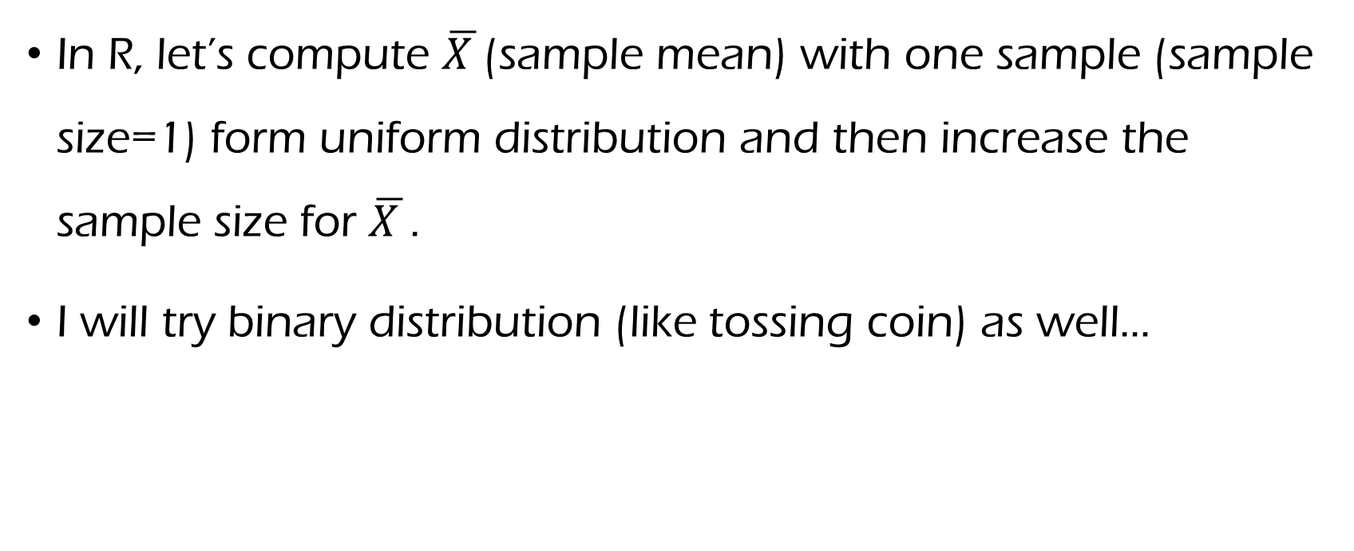
Topic 4 in Workshop (C): Sampling Distribution and CLT
In R, let’s compute $\overline{X }$(sample mean) with one sample (sample size=1) form uniform distribution and then increase the sample size for $\overline{X }$.
I will try binary distribution (like tossing coin) as well…

Slide 26
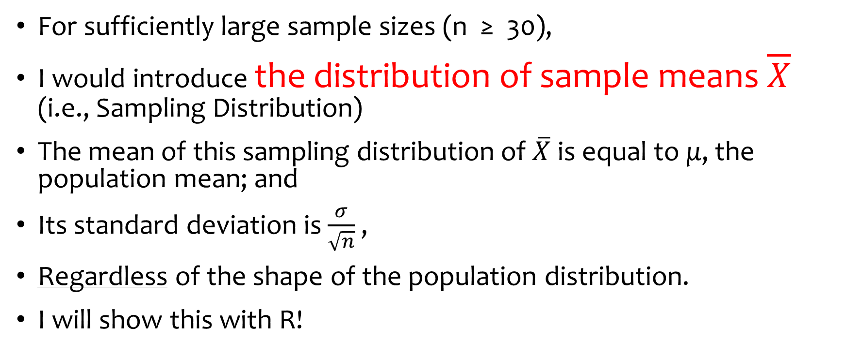
So, we have “Central Limit Theorem”!!
For sufficiently large sample sizes (n ≥ 30),
I would introduce the distribution of sample means $\overline{X}$ (i.e., Sampling Distribution)
The mean of this sampling distribution of $\overline{X}$ is equal to μ, the population mean; and
Its standard deviation is $\frac{σ}{\sqrt{n}}$ ,
Regardless of the shape of the population distribution.
I will show this with R!

Slide 27
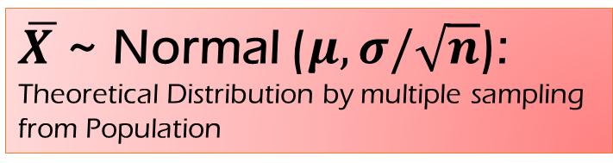
Now, what?
What managers really want to know (e.g., mean satisfaction of target population)
μ
What we observed from Sample
$\overline{X }$~ Normal ($μ,σ/\sqrt{n}$):
Theoretical Distribution by multiple sampling from Population

Slide 28
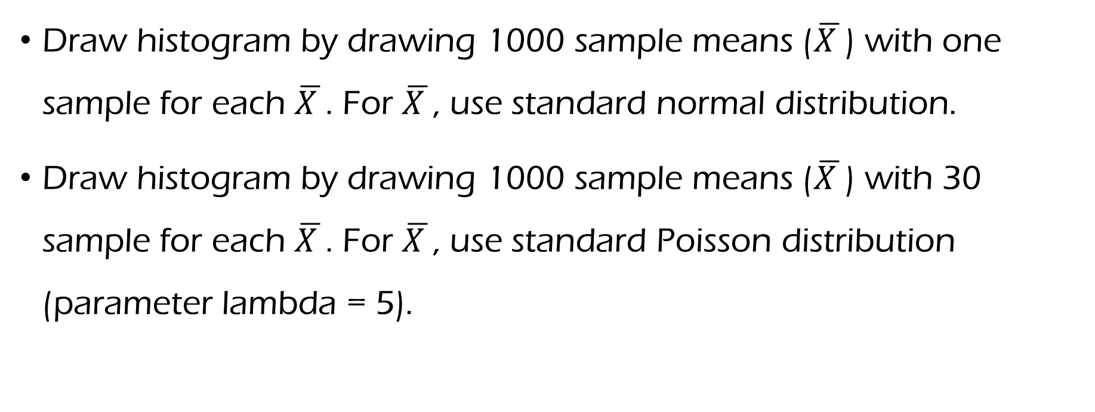
R Practice: CLT simulation
Draw histogram by drawing 1000 sample means ($\overline{X }$) with one sample for each $\overline{X }$. For $\overline{X }$, use standard normal distribution.
Draw histogram by drawing 1000 sample means ($\overline{X }$) with 30 sample for each $\overline{X }$. For $\overline{X }$, use standard Poisson distribution (parameter lambda = 5).

Slide 29
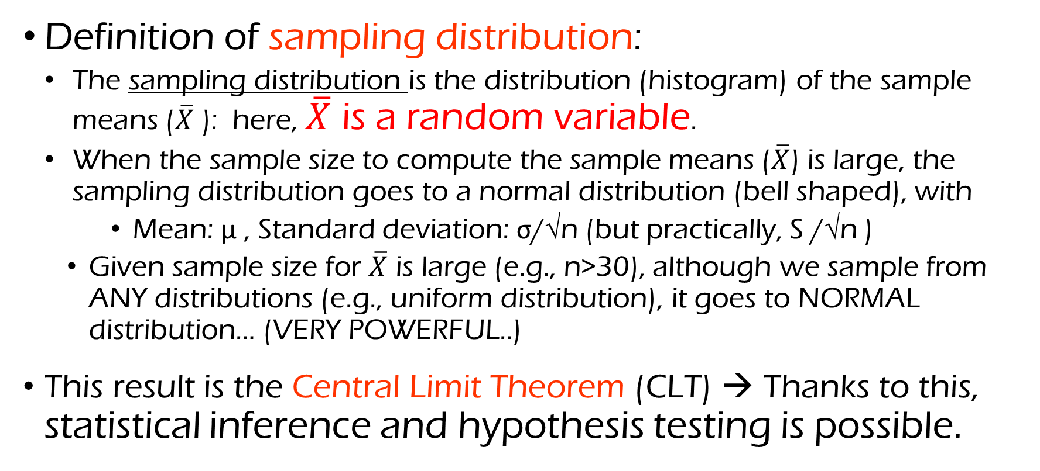
Recap: Sampling distribution and the central limit theorem (CLT)
Definition of sampling distribution:
The sampling distribution is the distribution (histogram) of the sample means ($\overline{X}$ ): here, $\overline{X}$ is a random variable.
When the sample size to compute the sample means ($\overline{X}$) is large, the sampling distribution goes to a normal distribution (bell shaped), with
Mean: μ , Standard deviation: σ/√n (but practically, S /√n )
Given sample size for $\overline{X}$ is large (e.g., n>30), although we sample from ANY distributions (e.g., uniform distribution), it goes to NORMAL distribution… (VERY POWERFUL..)
This result is the Central Limit Theorem (CLT) → Thanks to this, statistical inference and hypothesis testing is possible.

Slide 30
Topic 5 in Workshop (C): Basic Plots of Descriptive Statistics with Professor Data
Histogram
Boxplot, grouped boxplot
R includes great packages for data visualization (e.g., ggplot2, lattice, etc.). For example,
https://www.r-exercises.com/tag/data-visualization/
https://tutorials.iq.harvard.edu/R/Rgraphics/Rgraphics.html
I personally prefer simple black and white plots… but these R packages help you draw fancy ones.

Slide 31
R Practice: Data visualization
Practice same graphical summaries with the Instagram data…
Challenge: Draw two histogram plots in one figure (by searching this online) – You can use any package (e.g., ggplot2)

Slide 32
Topic 6 in Workshop (C): Frequency Descriptive Analysis
Frequency Table
Cross Table (We will learn details about this with marketing implications soon.)

Slide 33
Topic 7 in Workshop (C): Multiple Panels in a window for your report
For helping your report, you can draw multiple panels in a plot, which is useful for your report.

Slide 34
R Practice: Multiple plots in a window
Draw 2 X 2 panel plots in a window
On top two histograms of yrs.service and salary
On bottom two scatter plots of (1) yrs.since.phd and salary; (2) yrs.service and salary.

